Slide 1

Correlation between
numerical features
DATA ANALYTICS | IRONHACK

Slide 2

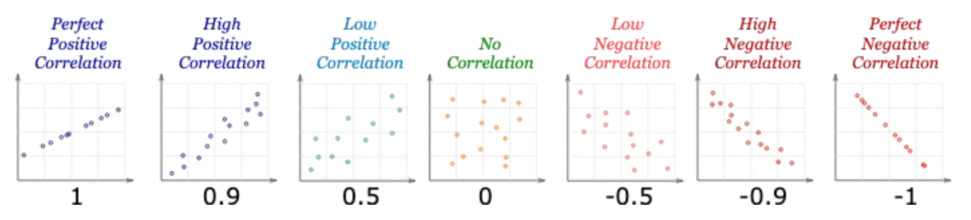
IRONHACK BOOTCAMP
LINEAR CORRELATION
The correlations quantifies how much linearly related are two numerical variables.
The correlation coefficient can be positive, negative or null
The range of values is: -1, 1
Correlation doesn’t imply causation

Slide 3
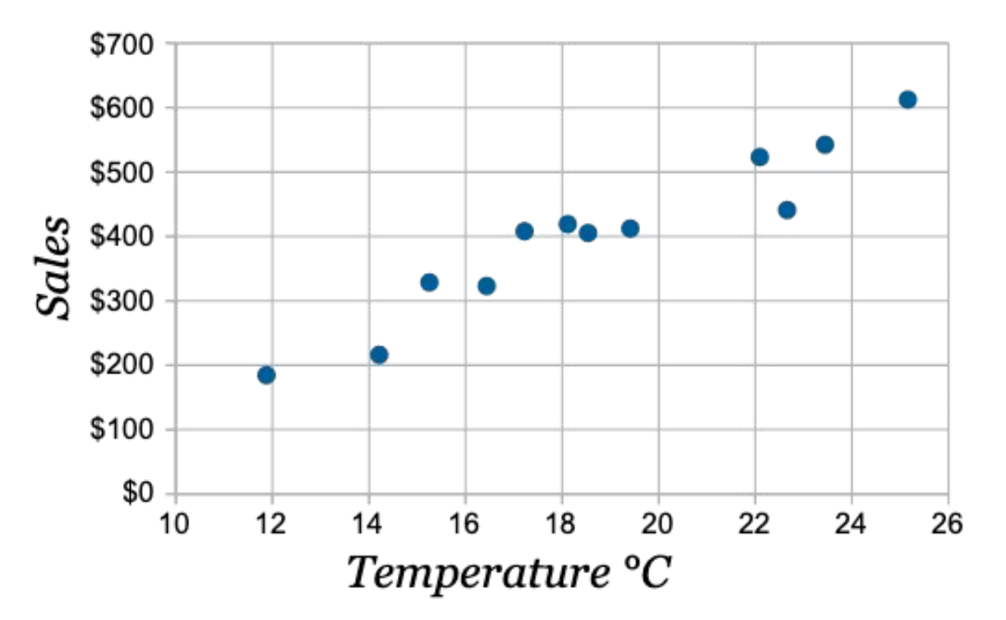
IRONHACK BOOTCAMP
LINEAR CORRELATION EXAMPLE

Slide 4
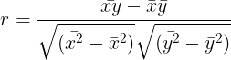
IRONHACK BOOTCAMP
QUANTIFYING LINEAR CORRELATION
The correlation is given by:

Slide 5
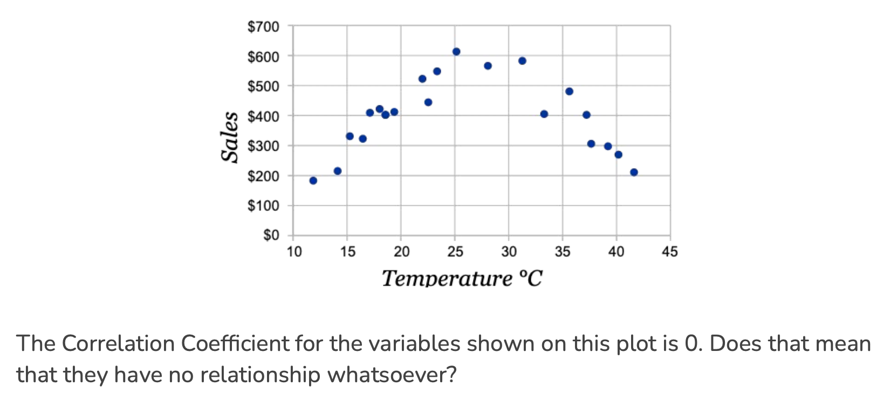
IRONHACK BOOTCAMP
LACK OF LINEAR CORRELATION DOESN’T MEAN LACK OF RELATIONSHIP!

Slide 6


